Slide 1



Driver’s Sleepiness Detection System
-By
Jay Mishra
Harsh Bhagwani
Himanshu jain

Slide 2
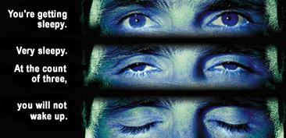
From Dept. of Public Safety campaign:

Slide 3

Motivation (1)
A study (In the INDIA) showed that 21% of drivers surveyed admitted to falling asleep at the wheel.
An estimated 1.48 million drivers have been involved in a drowsy driving related crash in the past five years.
Fall-asleep crashes are likely to be serious. The morbidity and mortality associated with drowsy-driving crashes are high, perhaps because of the higher speeds involved combined with delayed reaction time.

Slide 4
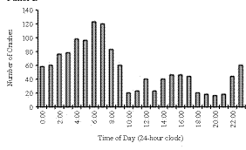
Motivation (2)
Accidents study in the INDIA (2000-20):
Time of occurrence of crashes in drivers at ages 26 to 45 in which the crashes were attributed by the police to the driver being asleep (but in which alcohol was not judged to be involved).
The X axis is the time of day and the Y axis is the number of crashes.

Slide 5

Project Goal
Simulate sleepiness detection system using image processing methods.

Slide 6
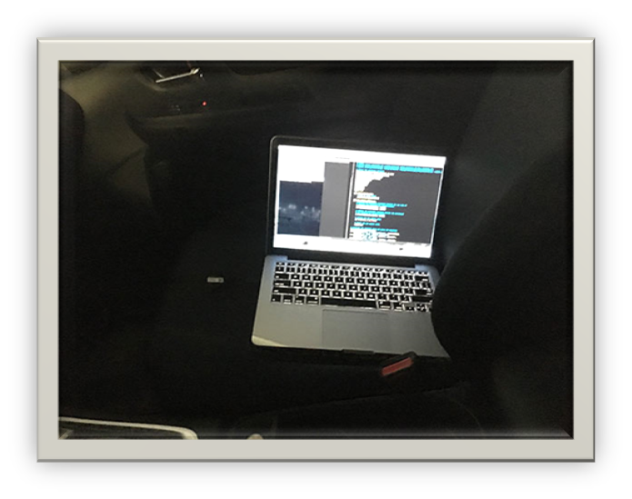
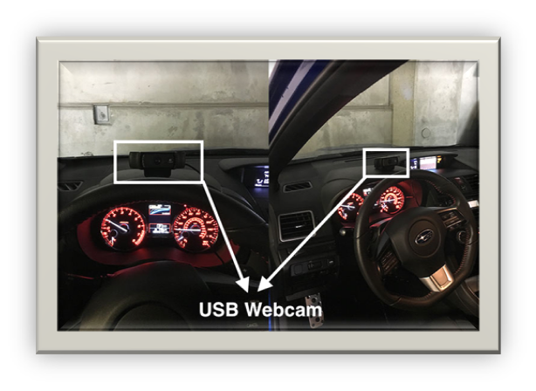
Tools
WEB Camera
Python 3.5 and above
Windows and Ubuntu

Slide 7
The (ideal) idea:
A video camera placed inside the car is continuously filming the driver’s face during the ride.
A detection system analyses the movie frame by frame and determines whether the driver’s eyes are open or shut.
If the eyes are shut for more than 1/4 a second (longer than a normal blink period) then the systems beeps to alert the driver.

Slide 8

In Practice
The system is only a simulation of such detection system, and can perform real-time detection & analysis.
However, it does work on a given video file with a given set of parameters.

Slide 9
Implementation - General
A Python program.
Take image as input from camera
Detect the face in the image and create a Region Of Interest (ROI).
Detect the eyes from ROI and feed it to the classifier.
Classifier will categorize whether the eyes are open or closed .
Calculate the score to check whether the person is drowsy.
Give output as Drowsiness Index and driver warning

Slide 10
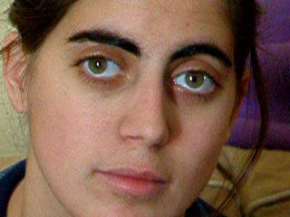
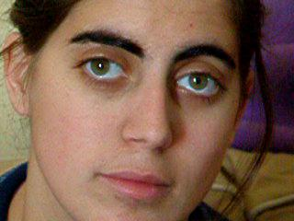
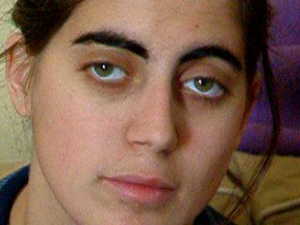
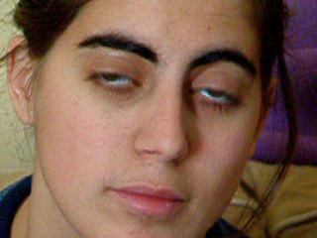
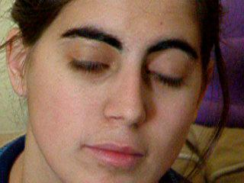
Implementation – Step by Step (1)
The movie is extracted to frames:
30 frames
per second

Slide 11
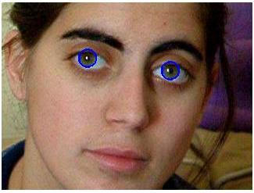
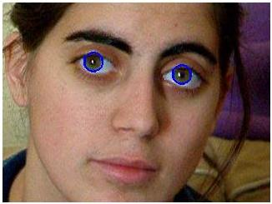
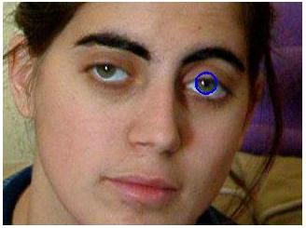
Implementation – Step by Step (2)
Perform Circular Hough transform on each frame in order to detect the irises:
Mark the circle detected
in blue circle

Slide 12

Implementation – Step by Step (3)
If score becomes greater than 15 that means the person eyes are closed for a long time. This is when we beep the alarm.

Slide 13
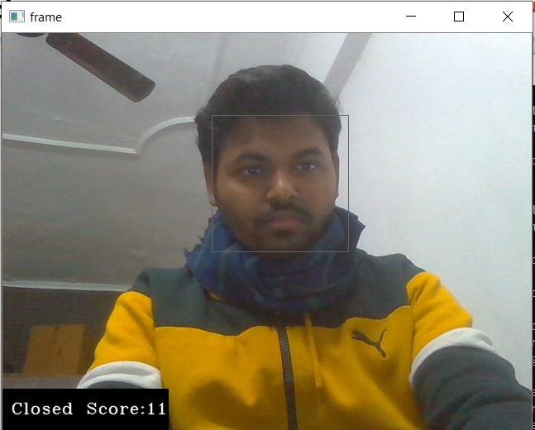
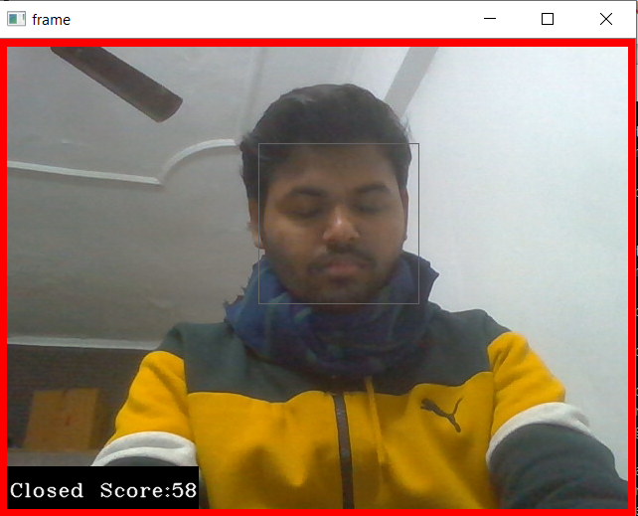
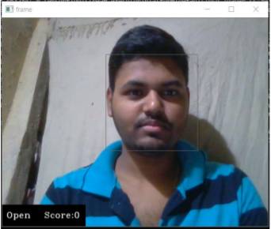
Ouput Will look like this

Slide 14

Conclusions
In order for the system to detect sleepiness successfully, a set of parameters need to be given to the system manually, and might vary from video to video (threshold, radius).
Python works slow and uses a lot of virtual memory – might not be good enough for real-time solution.
Wearing glasses (of any kind) sometime cause the system to fail.

Slide 15

Future Work
Improving the algorithm:
  Study the location of the eyes in the first image, and create a search area around the eyes for the following frames.
  Use other parameters like blink-rate, yawning, state of car etc.
Make the system work in real-time environment.

Slide 16


Questions?

Slide 17
References
DROWSY DRIVING AND AUTOMOBILE CRASHES:
http://www.nhtsa.dot.gov/people/injury/drowsy_driving1/drowsy.html
Federal Motor Carrier Safety Administration:
http://www.fmcsa.dot.gov/
Computational Efficient Face Detection: S. Romdhani, P. Torr
B. E. Boser, I. M. Guyon and V. N. Vapnik, "A training algorithm for optimal margin classifiers", Proc. of the 5th ACM Workshop on Computational Learning Theory, pp. 144-152, 1992.

Slide 18
Thank You

